Slide 1
JIHADI INFLUENCE IN EUROPE
TRIVALENT PROJECT, ROME, JUNE 2019

Slide 2
WHO WE ARE
A EUROPEAN NETWORK
A network of 27 EU Member States;
Funded by the EU Commission;
Belgian-led, UK expertise.
Notes:
Suggested speaking notes:
- Who are our members? Mainly MoI
CUTA – BE fusion center
RICU – UK HO

Slide 3
WHAT WE DO
CVE STRATEGIC COMMUNICATIONS
1. Network
2. Research
3. Consultancy
Notes:
3 pillars of activities
Share analysis, good practices and ideas;
Connect governments, private sector and civil society;
Collaborate to produce insights and responses.

Slide 4
WHAT WE DO
WHY STRATEGIC COMMUNICATIONS
How govs achieve a strategic effect through communications;
What are the grievances and vulnerabilities of vulnerable audiences;
How to change attitudes and behaviours in vulnerable audiences;
What govs need to say, to whom, and by what means.

Slide 5
WHAT WE DO
OUR APPROACH
Define the problem
Understand the audience
Design the architecture
Build the partnerships
Deliver the campaigns
Evaluate the performance
Report the success

Slide 6
THE ARCHITECTURE
OUR APPROACH

Slide 7
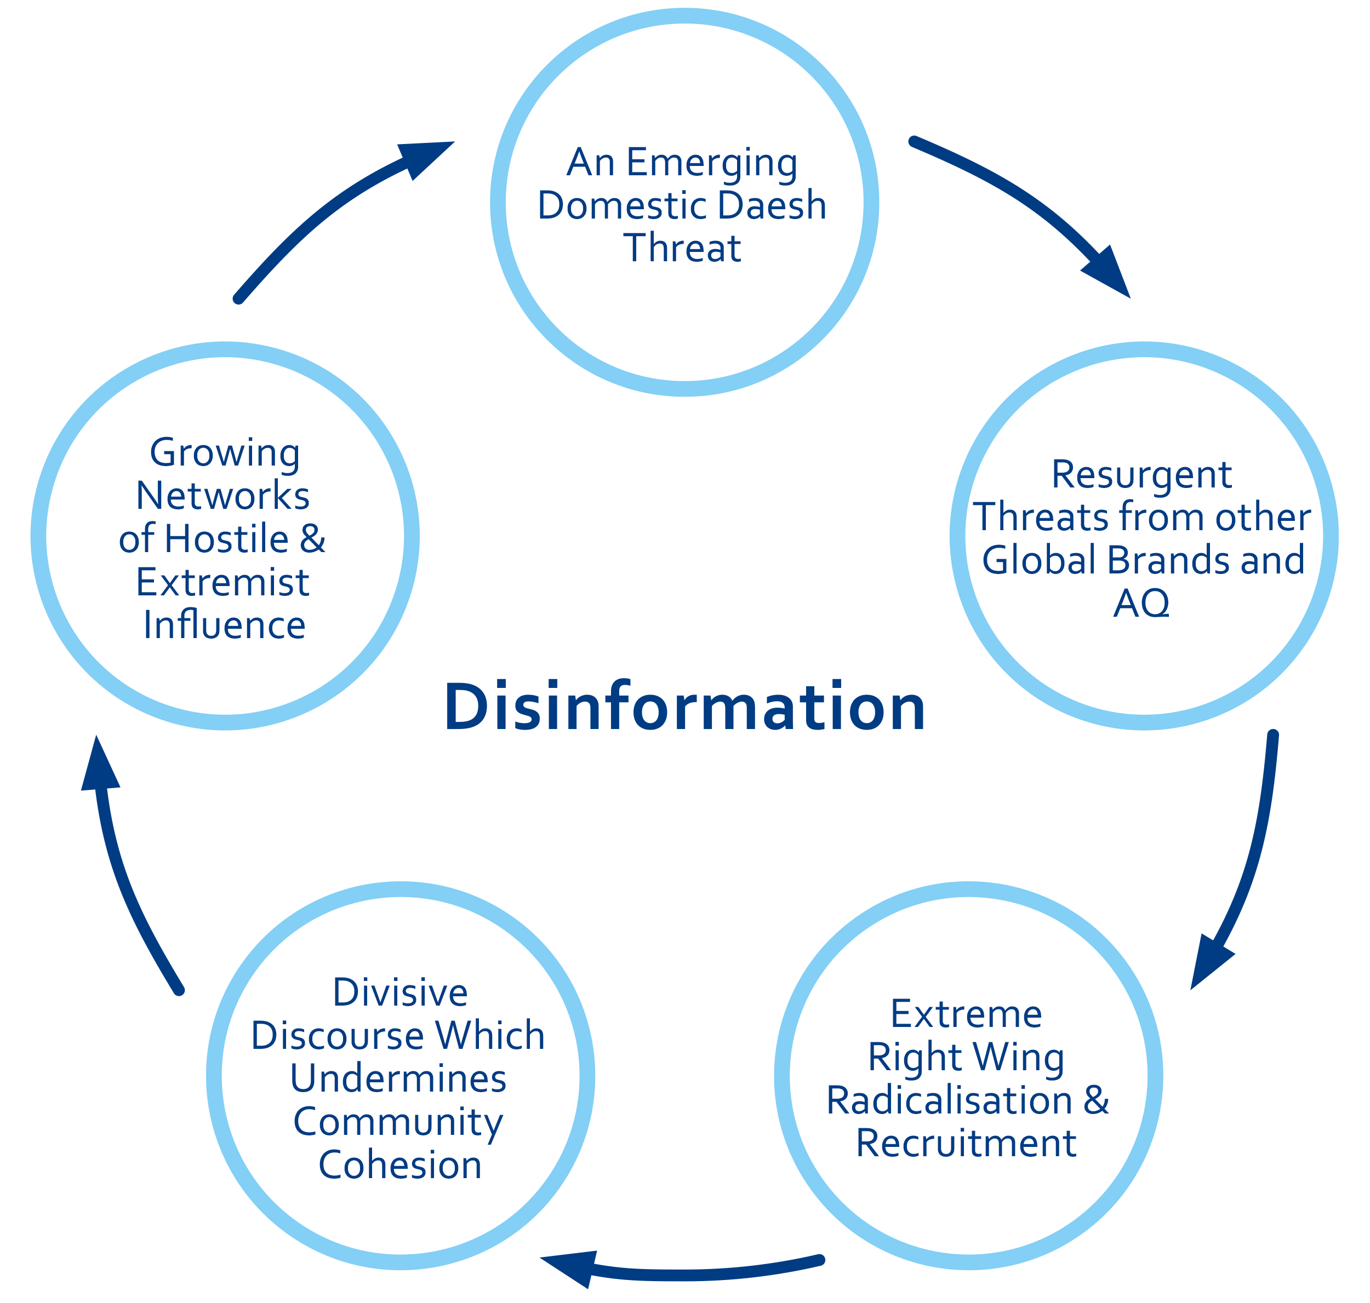
RESEARCH
THE PROBLEM SET

Slide 8
ESCN insights on ‘Jihadi Influence in Europe’
Notes:
In January 2019 the ESCN launched a Research & Analysis Working Group to explore several of the communications challenges listed in the ESCN Problem Set Paper (May 2017): ‘Daesh’, ‘Al Qaeda and other Jihadi Groups’ and ‘Operating Networks’.

Slide 9
WHY NOW
INSIGHTS INTO JIHADI SCENE IN EUROPE
Territorial defeat of Daesh and (re)emergence of other Jihadi groups;
Focus on individuals and audiences;
Provide insight and recommendations to policy makers.
Notes:
CONTEXT
Territorial defeat of Daesh and (re)emergence of other Jihadi groups;
LOOKING BEYOND DAESH
Communications challenge posed by Jihadi groups;
DO GROUPS REALLY MATTER (mixed sources of jihadi propaganda)
Focus on individuals and audiences;
OBJECTIVE AND AUDIENCE OF THE PAPER
Provide insight and recommendations to policy makers.

Slide 10
HOW WE DID IT
THE PROCESS
Research & Analysis Working Group;
Network Meeting in Brussels;
External research.
Notes:
WG: 14 Member States (DE, ES, DK, BE, FI, UK, SE, PT, EL, BG, HU, MT, RO, IT) and 4 Institutions (Europol, EEAS, EUCTC and GCCC) joined the Working Group and met in Madrid in February 2019.
NM9: In May 2019, an ESCN Thematic Event on ‘Jihadi Influence in Europe’ brought together governments, civil society and private sector to assess the current jihadi threat in Europe and explore potential avenues of response.
External research: ethnographic study to assess what (online and offline) influences, by whom and how, have a positive or negative effect on the attitudes of young Muslims in Brussels.

Slide 11
THE PAPER
CONTENT
Ideology
Narratives
Grievances
Audiences
Channels
Impact

Slide 12
THE PAPER
IDEOLOGY
Salafi-Jihadi ideology
The role of theology
Takfir and Jihad
Notes:
Ideology came up strongly at the first meeting of the WG. Some MSs more worried than others.
Ideology - Several EU governments are increasingly concerned about the increased spread of a specific Salafi-Jihadi ideology among their communities, and the consequent isolation and polarisation that such an ideology can create in those communities. Has it been mainstreamed?
Ideology is not theology, but jihadis use the latter to promote the former. What is the role of ideology in the radicalisation path? Not clear…
Jihadis weaponise theology as a mean to promote political ideology. Daesh has not reinvented theology…but embedded it in its propaganda. Some concepts like takfir have been reintroduced to mark the difference between the in and out-group.

Slide 13
THE PAPER
NARRATIVES
Defenders of the Ummah
Warfare
Victimhood
Notes:
Not exhaustive list! We have selected those that are currently more relevant in the jihadi scene.
1. the portrayal of their own group as defenders of ‘true Islam’. They use religious texts to demonstrate the distinction between what they consider to be ‘real Muslims’ on the one hand and non-believers and hypocrites on the other. -> Call to action - advocate for lone-actor and low-tech attacks
2. Evolution of the first one. You need to defend the ummah from the enemies. A wider apocalyptic struggle; heroes and martyrs
3. Presenting global news events through the lens of Muslim oppression

Slide 14
THE PAPER
GRIEVANCES
Injustice and mistrust
Sense of identity
’Übermuslim’
Notes:
Jihadis exploit personal grievances in local communities. We attempted to cluster them.
Injustice and mistrust
play on a sense of victimhood and injustice present in certain parts of the population. In this way they exploit and amplify personal or local grievances which results in certain communities becoming increasingly mistrusting towards the state and towards non-Muslims or even moderate Muslims resulting in isolated groups which try to minimize contact outside of the own community.
Foreign policy
Sense of identity
People that have a feeling of falling between several cultures, social groups or classes are particularly vulnerable of not feeling a sense of belonging to any of them. The issue becomes problematic when this makes people cling to one identity which takes over every aspect of their life.
Übermuslim
Muslims who have a very strong religious identity controlling every aspect of their lives but also distance themselves from ‘Western society’ and other Muslims who do not share their specific worldview e.g. Shiites or non-practising or moderate Muslims.

Slide 15
RESEARCH
AUDIENCES
RETURNEES
MIGRANTS
CONVERTS
PRISONERS
YOUNG ADULTS
Notes:
Returnees
Not a homogenous category – needs granularity
They come back radicalised – disengagement programs are needed
Gov coms and media
Migrants
No relation but migrants have vulnerabilities that can be exploited : cultural crash; sense of identity; needs for stability; war traumas
Exposed to foreign influences if the space is not contested, proper integration does not take place
Disadvantaged neighbourhoods
Converts
Difficult to define who is a convert – no consensus
Difficult to define links between conversion and radicalisation – no evidence
Pre-existing grievances
Prisoners
Proximity
Isolated → absence of family and social networks (protective factors; cognitive opening)
Inclined to buy victimhood narratives
Young adults
We always look at teens, but the range 20-30 is according to some the most problematic
Identity crisis
Job, family
[report from CUTA]

Slide 16
THE PAPER
CHANNELS
Ecosystem of intermediaries and advocates
Offline echo chambers
Mainstream platforms and encrypted channels
Mainstream media and ‘ripple effect’
Notes:
Ecosystem of intermediaries and advocates
Schools, mosques, prisons → through polarizing narratives create sectarianism (offline echo chamber)
Mainstream platforms – used to have reach, but also move into more private environments
Mainstream media and researchers as message amplifiers

Slide 17
THE PAPER
IMPACT
Non-violent groups creating fertile ground for radicalisation
Jihadi groups capitalising on local events
‘Propaganda of the deed’
Reciprocal influence between Jihadists and far-right/left
Notes:
Local events e.g. gilet jaunes
Through mainstream media and then social networks propaganda reaches wider audiences into our society, UNINTENDED audiences which are affected
RW reacting to jihadi
LW protective stance towards migrants and Islamist (islamophobia) → LW/RW
All are anti-Semitic

Slide 18
WHAT GOVERNMENT SHOULD DO
RECOMMENDATIONS
Group agnostic approach
Whole of society approach
(permissive environments)
Govt comms and responsible journalism
Counter-ideology vs alternative narratives
Propaganda of the deed & terminology
Address vulnerabilities
Support moderate, reconciled Muslim voices
Contest the space
Notes:
Terminology (Jihad, Salafism, Muslim community)

Slide 19
THANK YOU
Luke Havill - luke@escn.ibz.eu
Giulia Giacomelli - giulia@escn.ibz.eu

